Slide 1
Chef vs. Puppet vs. Ansible vs. Saltstack:
Raghu

Slide 2
Summary
Chef, Puppet, Salt Stack, and Ansible are the top 4 DevOps Configuration Management tools. Choosing one over another can be a bit of a challenging task.

Slide 3
Saltstack
SaltStack configuration tool relies on a master-client setup model or a non-centralized model.
SaltStack is available in Python programming language and uses the push model for executing commands via SSH protocol.
The platform also allows to group together clients and configuration templates to control the environment easily.
It enables low-latency and high-speed communication for remote execution and data collection in sysadmin environments.

Slide 4
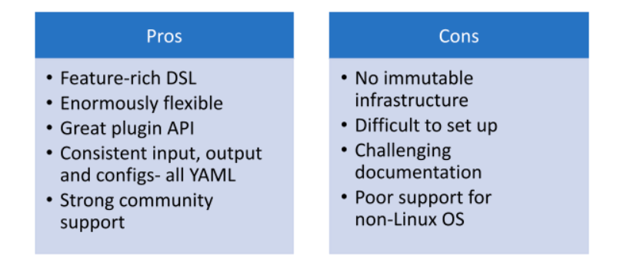

Slide 5
Puppet
Puppet is a full-fledged configuration automation and deployment orchestration solution.
It’s an open-source tool based on Ruby.
For working, it counts on a customized Domain Scripting Language (DSL) nearer to JSON.
It runs as a master-client setup and uses a model-driven approach. Large enterprises use it widely to automate sysadmins who spend ages configure, provision, troubleshoot, and maintain server operations.

Slide 6
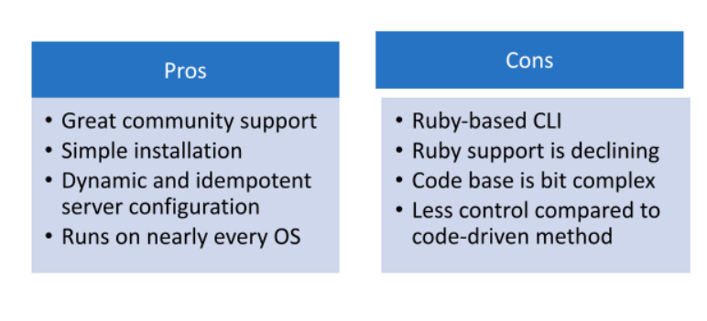

Slide 7
Chef
The chef is an automation platform that provides an effective way to configure and manage infrastructure.
The chef works on Ruby and DSL language for writing the configurations.
Its architecture is like the Puppet master-agent model.
It also uses a pull-based approach and an additional logical Chef workstation to control configurations from the master to agents.
It provides a configuration in a Ruby DSL using a client-server architecture.

Slide 8
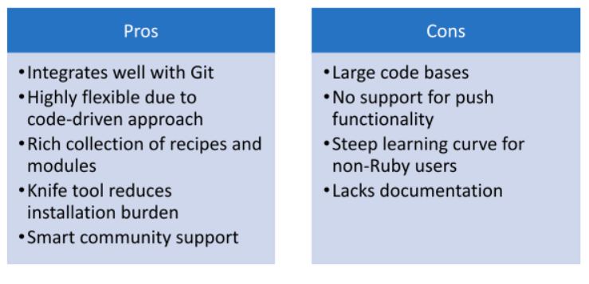

Slide 9
Ansible
Ansible simplifies complicated orchestration and configuration management tasks.
It is in Python language and allows users to script commands in YAML as a necessary programming paradigm.
Ansible offers several push models to send command modules to nodes through SSH, which runs sequentially.

Slide 10
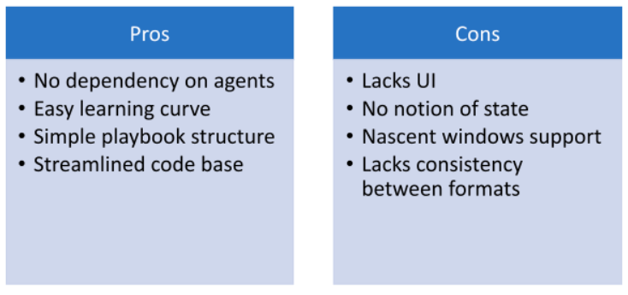

Slide 11
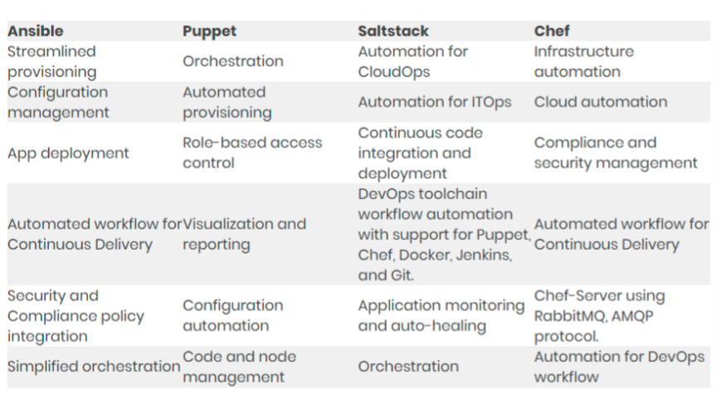
A Glimpse on Tool Capabilities

Slide 12
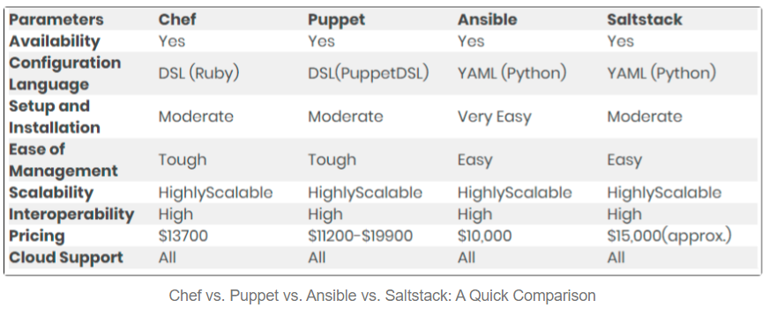

Slide 13
Final Words
It is tough to say which one is best over another. Why? Because all these tools have a specific role. Their utilization depends entirely on configuration needs, support, and the convenience level to implement them. However, for better decision making, here is a tip: Choose Chef and Puppet as they are old and more established. It makes them perfect for large enterprises that value maturity and stability over simplicity. Ansible and SaltStack are decent options for fast and simple solutions while working in environments that do not need support for quirky features.

